Slide 1


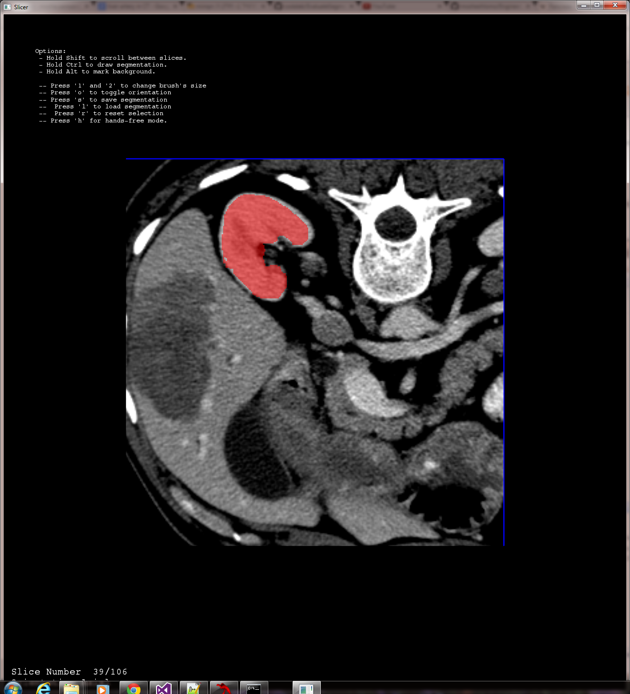
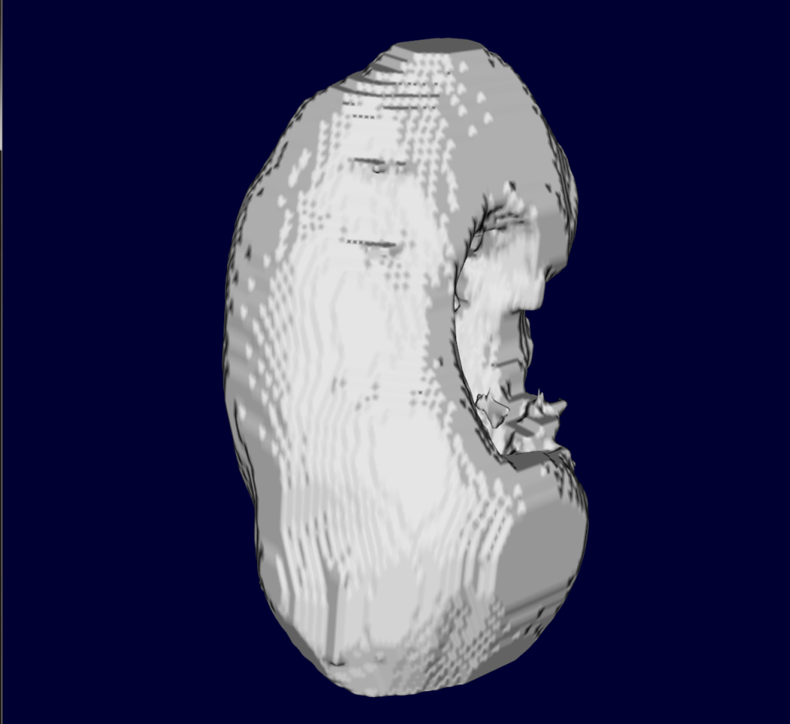
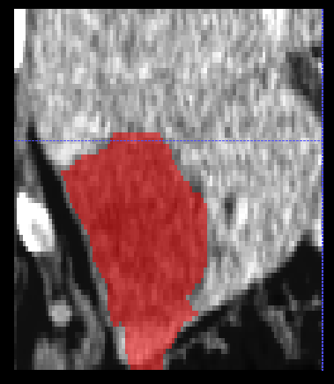
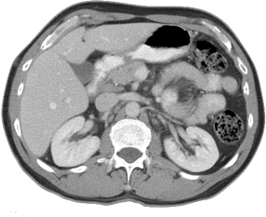
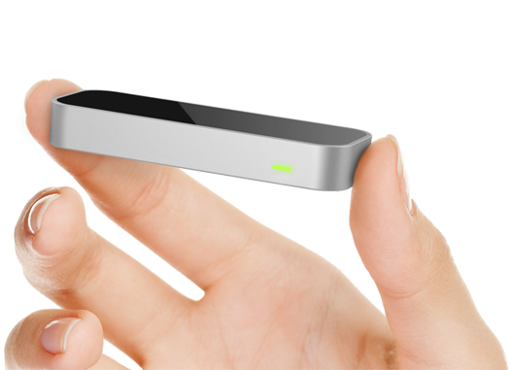
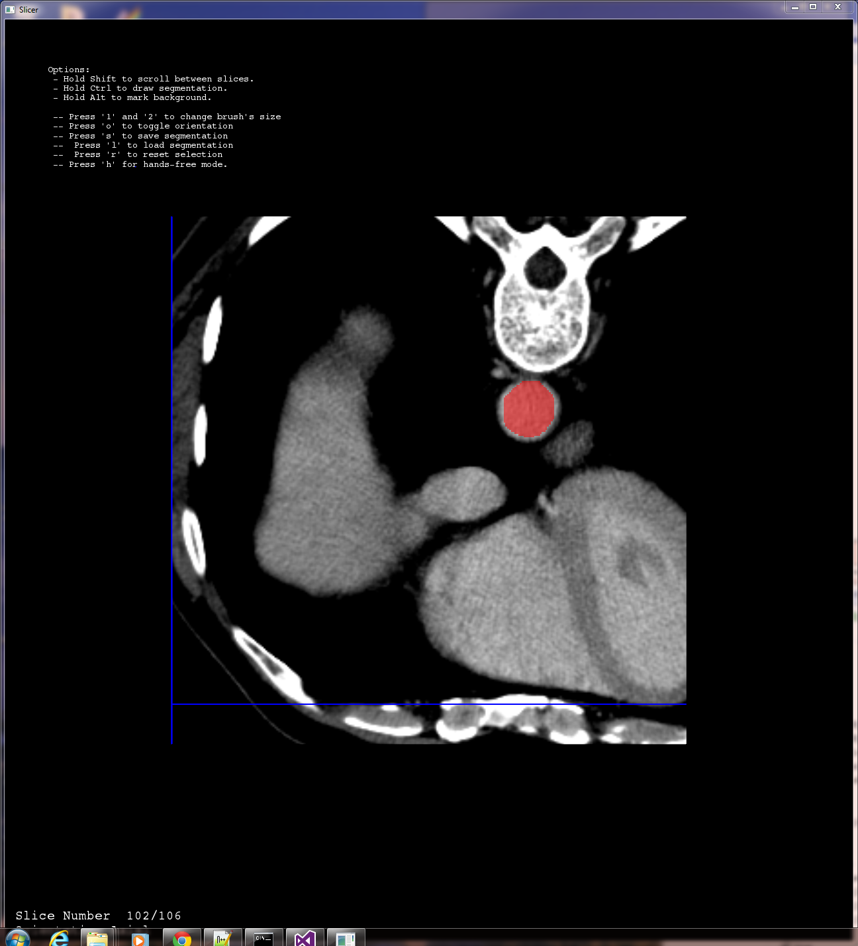
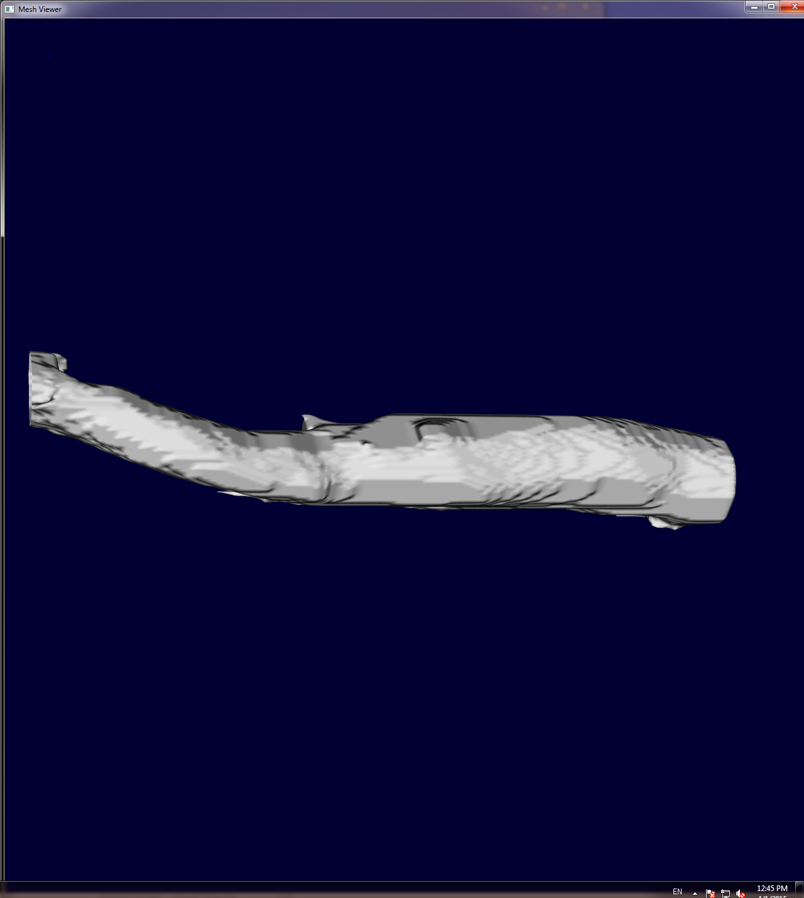
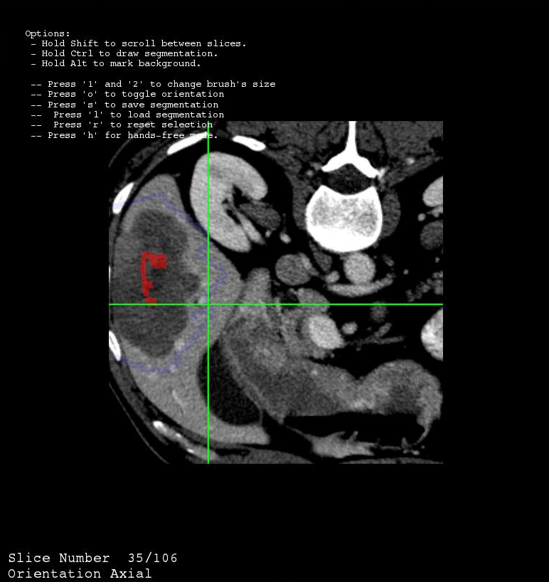
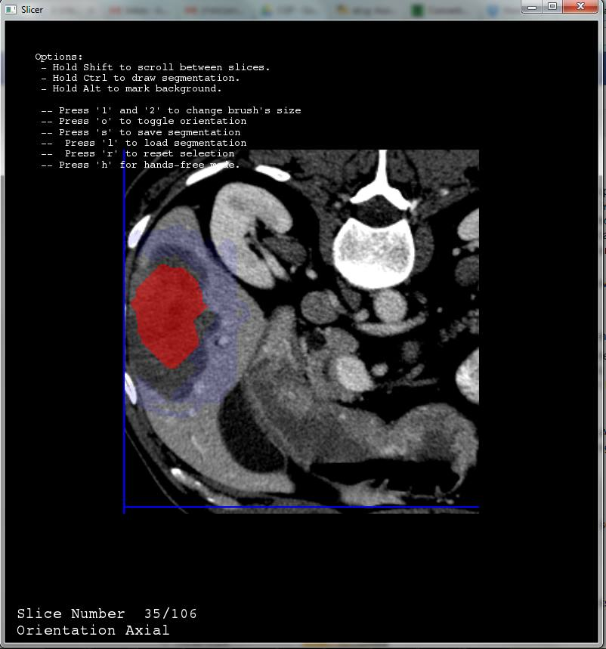
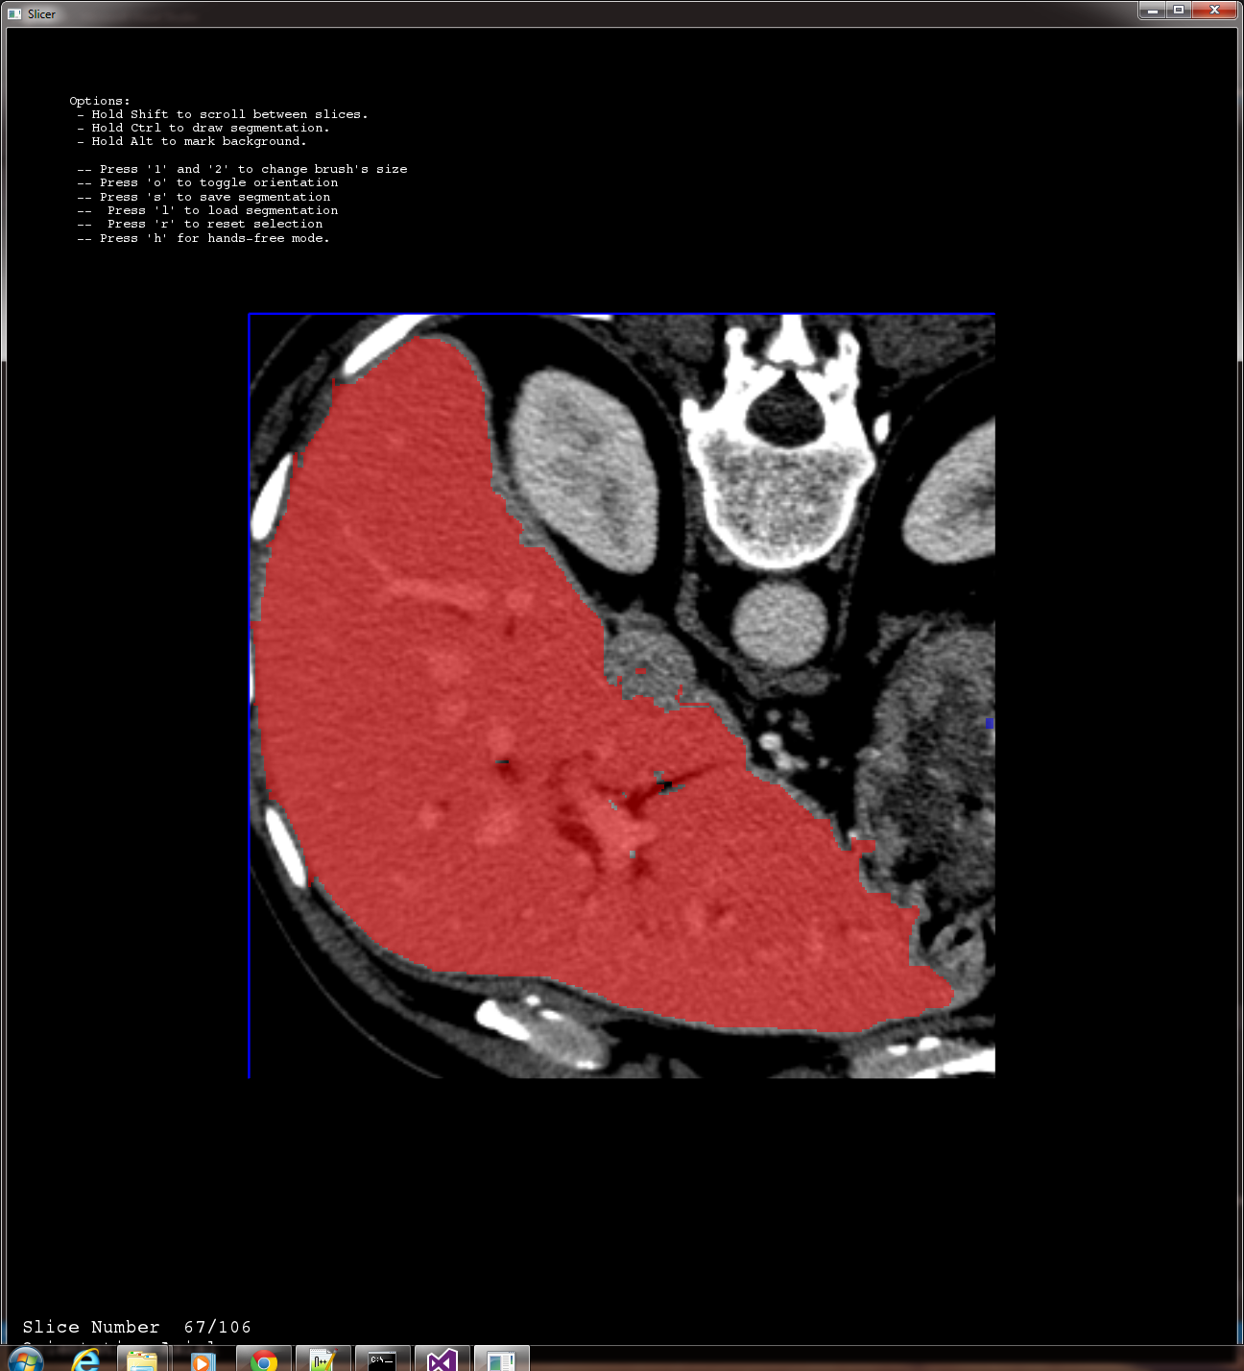
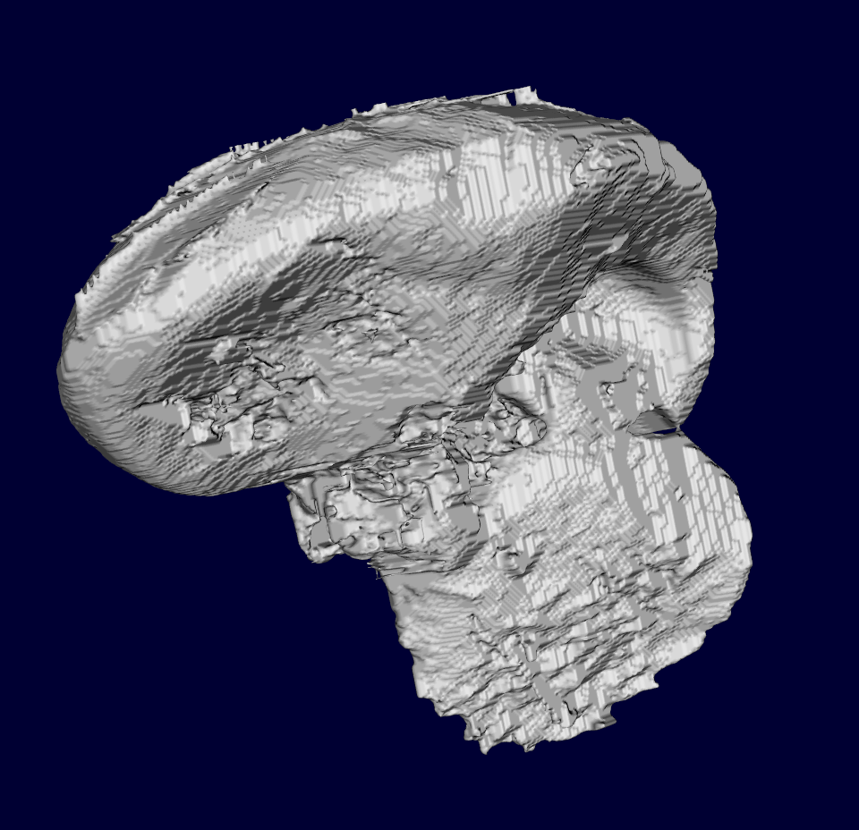
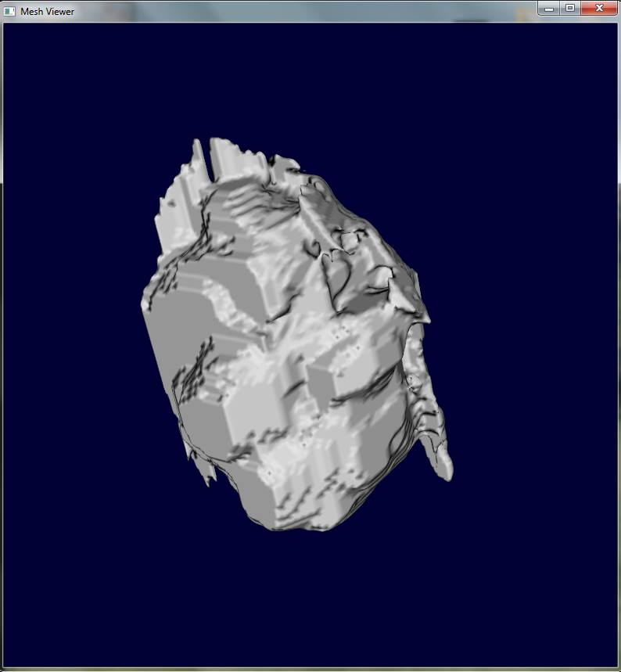
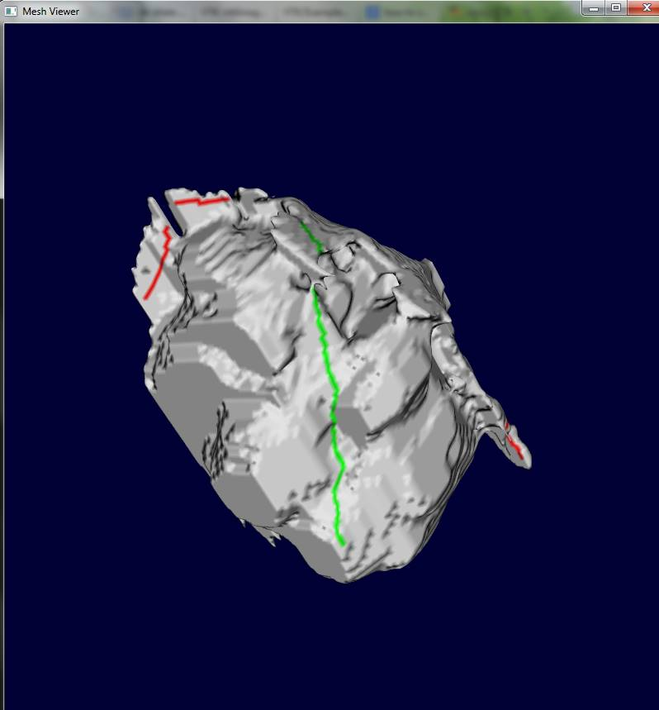
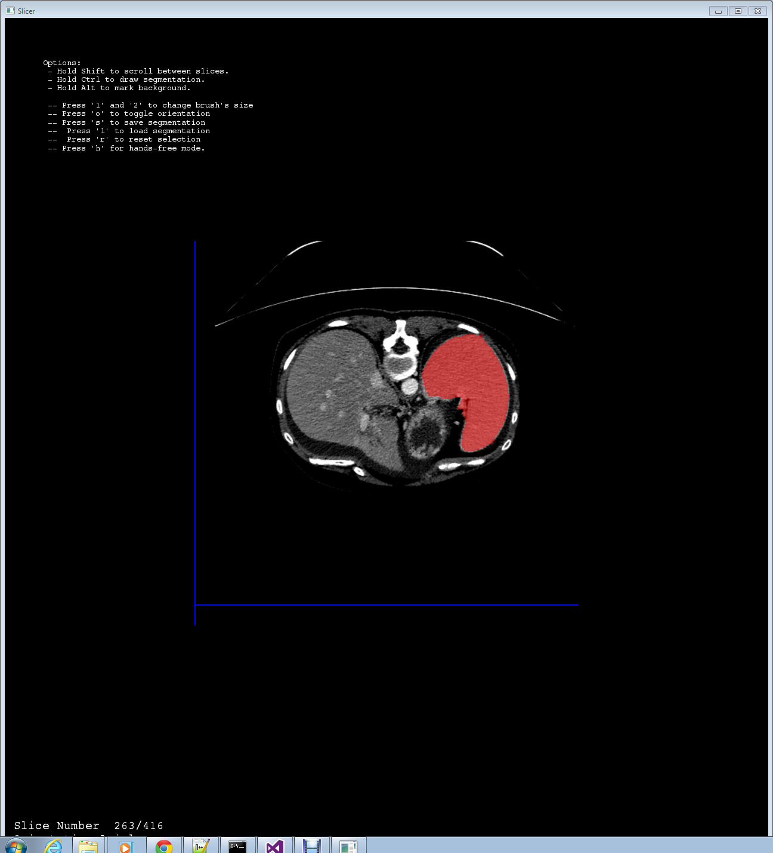
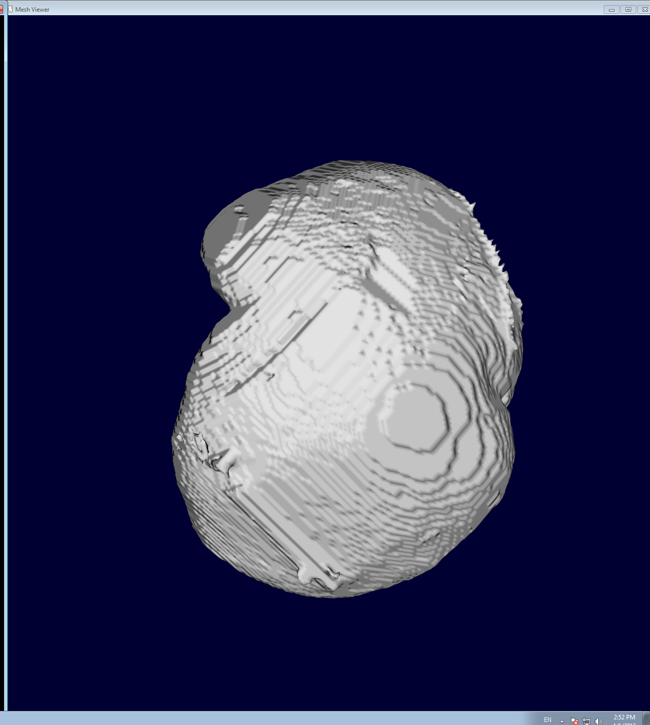
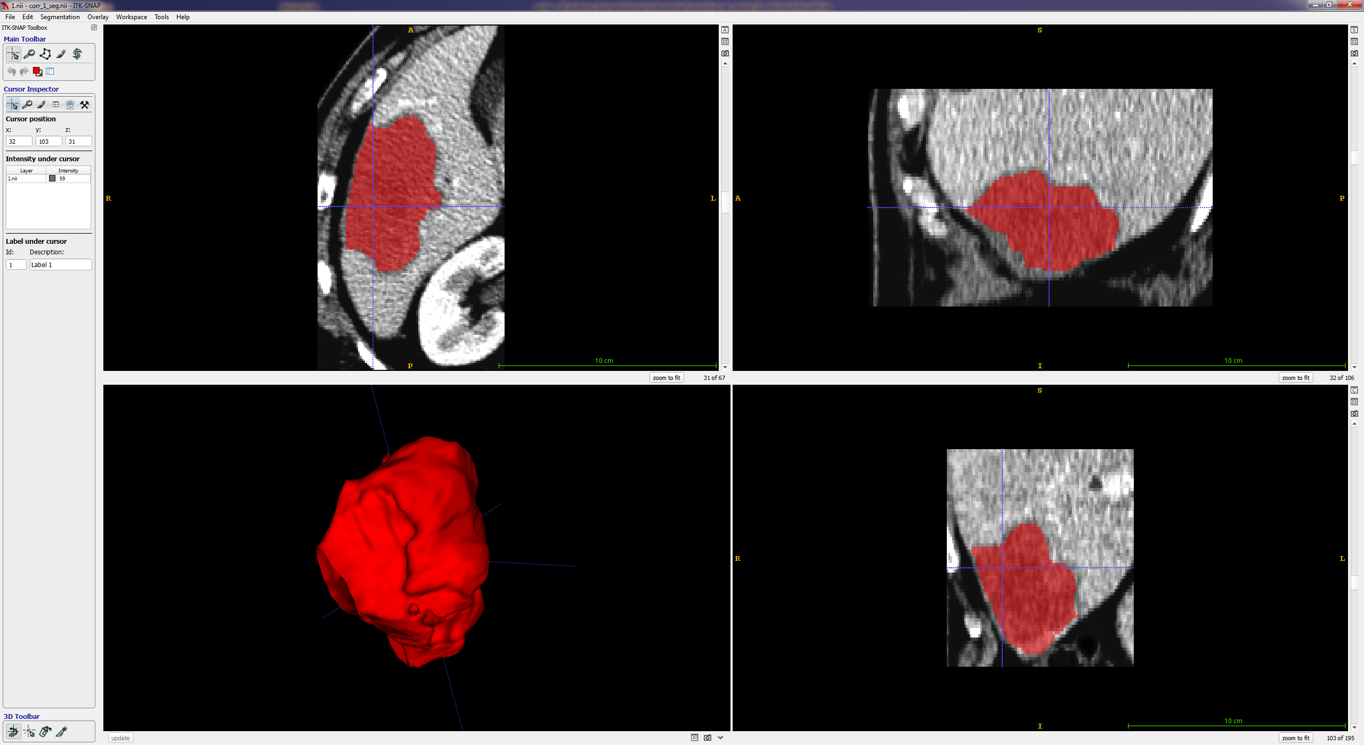

3D Anatomy Segmentation using Perceptual Computing
S. Shenzis, M. Samson, R. Vivanti , L. Joskovitz
The Rachel and Selim Benin School of Computer Science and Engineering The Hebrew University of Jerusalem
Email: shlomo.shenzis@mail.huji.ac.il moshe.samson@mail.huji.ac.il
Introduction
Motivation
The Problem
The segmentation of anatomical structures in volumetric scans is a challenging and time-consuming task.
Segmentation is hard – low tumor-to-liver contrast (~30 HU), poor quality or resolution.
Inaccuracies – segmentation leaks
Time Consuming interaction
Tedious task
Our Solution
A semi-automatic tool for 3D segmentation in volumetric medical scans using natural input from the user.
Segmentation and 3D mesh of the kidney
Method
Input
Trachea
CT slices
Hand motion and gestures acquired by the Leap Motion
Output
2D – Correct segmentation of the anatomy.
3D – Mesh of the corrected anatomy.
Input: CT slices
Leap Motion Device
Segmentation
3D Mesh
Liver
Algorithm
Initial Scribble on 2D slices
Input acquired by natural interaction with the user: hand gestures and finger tracking.
Segmentation
Grow-Cut algorithm.
Correction Scribbles on 3D Mesh
Annotate lesions versus correct regions on the 3D anatomy mesh.
Leaks Removal
3D correction of segmentation lesions using contour smoothness value.
Repeating stages 1-2, 3-4
Iteratively repeat stages 1-2 and 3-4, until a satisfying result is obtained.
(1)
(2)
Segmentation
3D Mesh
Pancreas
(3)
(3)
(4)
(4)
Segmentation
3D Mesh
(4)
(4)
Kidney
Results and Validation
Experimental Results - quantitative examination
 | VOE | VS | AHD
CASES | 0.75579 | 0.89359 | 0.61523
 | 0.90427 | 0.99365 | 0.13195
 | 0.91288 | 0.96977 | 0.22423
 | 0.86508 | 0.89655 | 0.3529
 | 0.84497 | 0.88513 | 0.29112
 | 0.83341 | 0.89295 | 0.38871
 | 0.87731 | 0.90688 | 0.19493
 | 0.83349 | 0.96431 | 0.32338
 | 0.85409 | 0.88251 | 0.2295
 | 0.81009 | 0.84031 | 0.45791
MEAN | 0.8491 | 0.9126 | 0.3210
STD | 0.0459 | 0.0477 | 0.1419
MIN/MAX | 0.75579/ 0.91288 | 0.84031/ 0.99365 | 0.13195/ 0.61523
Segmentation
3D Mesh
10 cases from 10 different patients
Ground truth – Radiologists approved segmentation on CT.
Comparison metrics:
DICE volumetric overlap error (VOE)
Volumetric Similarity (VS)
Average Hausdorff Distance (AHD)
Summary
Semi-automatic 2D soft-anatomy segmentation using natural input
Grow-Cut algorithm for 2D segmentation
Graph-based lesions removal using contour smoothness and gradient as cost function.
0.8491% of Volumetric Overlap Error

